Slide 1

Reebok – Advanced Analytics Competitor behavior study

Slide 2
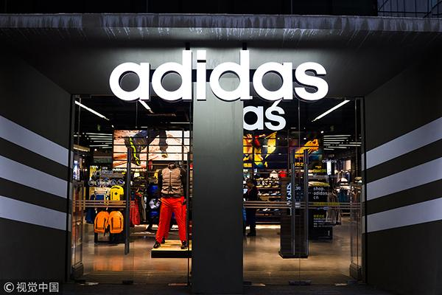



Problem Statement
Customer preferences/ Potential Customers/ Customer Behavior
Competitor- Adidas
Reebok shoe manufacturer
Notes:
Madison

Slide 3
Questions to Address:
Predict Consumer Behavior habits - based on region, sales pattern when competitor releases a new product
How this helps:
Performance among competitors - help focus on potential customers and manage inventory
Data needed:
Transaction data (ecommerce and in-store through our partnership), aggregate weekly sales data from different retailers by region, customer ratings, inventory data, and pricing data.
Notes:
Madison

Slide 4
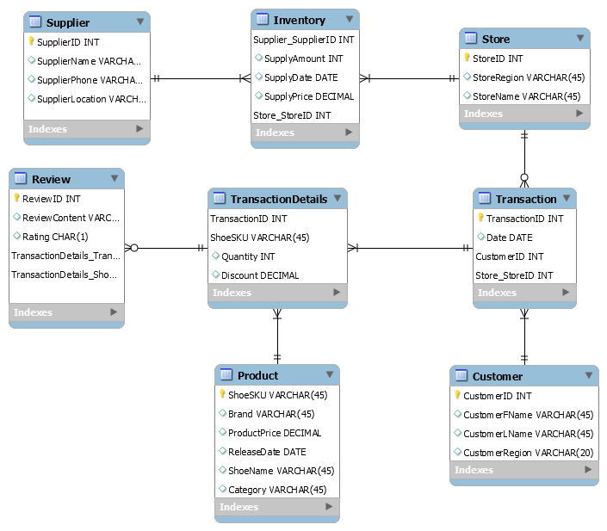
Schema Diagram
Notes:
Priya

Slide 5
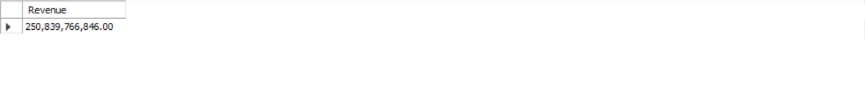
Sample Query
What are the internet sales behaviors of Reebok Shoes in the northeast region during one month when ‘Adidas’ has released its latest product one month (30 days) before?
SELECT SUM(p.ProductPrice*td.Quantity*td.Discount) AS “Revenue”
FROM TransactionDetails td, Product p, Store s, Transaction t
WHERE p.shoeSKU=td.shoeSKU AND t.Tran sactionID=td.TransactionID
AND s.StoreID=t.Store_StoreID AND p.Brand= ’Reebok’ AND c.CustomerRegion=”northeast” AND s.StoreID=1 AND
(t.DATE BETWEEN
(DATE(SELECT MAX(DATE(ReleaseDate) ) FROM Product WHERE Brand=’Adidas’))
AND
(DATE(SELECT MAX(DATE(ReleaseDate) ) FROM Product WHERE Brand=‘Adidas’)+30));
Notes:
Yan

Slide 6
Benefits of This Model
Regional analysis
Identify popular stores
Determine popular products
Find top customers
Monitor supply and inventory
Compare our sales performance with complex situations brought by our competitors
Use this data to increase profits
Marketing strategies
Supply strategies
Notes:
Xin

